Slide 1

APT 3010
Intro. To Artificial Intelligence.
Fall Semester-2022.
||Fredrick Michael Ogore||fogore@usiu.ac.ke|| Cell-No:0717105568||

Slide 2
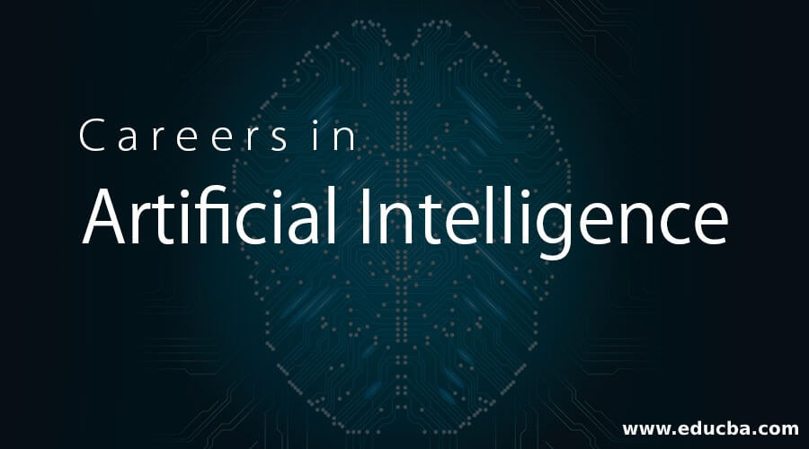
Notes:
Part1-Introduction

Slide 3
What is INTELIGENCE?
Dictionary definition.
(1) : the ability to learn or understand or to deal with new or trying situations : REASON; also : the skilled use of reason
(2) : the ability to apply knowledge to manipulate one's environment or to think abstractly as measured by objective criteria (as tests)
-Merriam-Webster's Collegiate Dictionary

Slide 4
What is INTELIGENCE?
Types of intelligence (Multiple intelligence theory, Howard Gardner)
    Linguistic-verbal intelligence
    Logical-Mathematical intelligence
    Musical intelligence
    Spatial intelligence
    Intrapersonal intelligence
    Interpersonal intelligence
    Naturalist intelligence
    Bodily-Kinesthetic intelligence
"What makes life interesting, however, is that we don’t have the same strength in each intelligence area, and we don’t have the same amalgam of intelligences. Just as we look different from one another and have different kinds of personalities, we also have different kinds of minds."
Theoretical foundations
for recognizing different
talents and abilities in
people

Slide 5
What is AI?
There is no agreed definition of the term artificial intelligence. However, there are various definitions that have been proposed. These are considered below.
AI is a study in which computer systems are made that think like human beings. Haugeland, 1985 & Bellman, 1978.

Slide 6
What is AI?
AI is a study in which computer systems are made that act like people. AI is the art of creating computers that perform functions that require intelligence when performed by people. Kurzweil, 1990.
AI is the study of how to make computers do things which at the moment people are better at. Rich & Knight
AI is a study in which computers that rationally think are made. Charniac & McDermott, 1985.
AI is the study of computations that make it possible to perceive, reason and act. Winston, 1992

Slide 7
What is AI?
“AI refers to the simulation of human intelligence in machines that are programmed to think like humans and mimic their actions.
The term may also be applied to any machine that exhibits traits associated with a human mind such as learning or problem-solving.”

Slide 8
Philosophy of AI.
While exploiting the power of the computer systems, the curiosity of human, lead him to wonder, “Can a machine think and behave like humans do?”
Thus, the development of AI started with the intention of creating similar intelligence in machines that we find and regard high in humans.

Slide 9
Goals of AI.
To Create Expert Systems − The systems which exhibit intelligent behavior, learn, demonstrate, explain, and advice its users.
To Implement Human Intelligence in Machines − Creating systems that understand, think, learn, and behave like humans.

Slide 10
AI HISTORY.
1943 McCulloch & Pitts: Boolean circuit model of brain
1950 Turing’s “Computing Machinery and Intelligence”
1950s Early AI programs, including Samuel’s checkers (draughts) program
Newell & Simon’s Logic Theorist, Gelernter’s Geometry Engine
1956 Dartmouth meeting: “Artificial Intelligence” adopted
1966–74 AI discovers computational complexity, Neural network research almost disappears
1969–79 Early development of knowledge-based systems
1980–88 Expert systems industry booms
1988–93 Expert systems industry busts: “AI Winter”
1985–95 Neural networks return to popularity
1988– Resurgence of probabilistic and decision-theoretic methods Rapid increase in technical depth of mainstream AI, “Nouvelle AI”: ALife, GAs, soft computing

Slide 11
BRANCHES OF AI.
Machine vision
Speech synthesis and recognition
Machine Learning
Robotics
Natural Language and understanding
Problem solving
Game playing

Slide 12
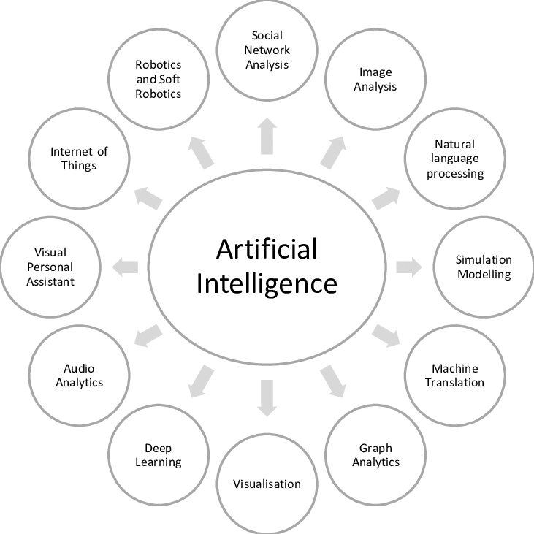

Slide 13
AI, a Multi-disciplinary domain.
Engineering:
  robotics, vision, control-expert systems, biometrics,
Computer Science:
  AI-languages , knowledge representation, algorithms, …
Pure Sciences:
  statistics approaches, neural nets, fuzzy logic, …
Linguistics:
  computational linguistics, phonetics en speech, …
Psychology:
  cognitive models, knowledge-extraction from experts, …
Medicine:
  human neural models, neuro-science,...

Slide 14
What Contributes to AI?
Artificial intelligence is a science and technology based on disciplines such as Computer Science, Biology, Psychology, Linguistics, Mathematics, and Engineering.
A major thrust of AI is in the development of computer functions associated with human intelligence, such as reasoning, learning, and problem solving.
Out of the following areas, one or multiple areas can contribute to build an intelligent system.

Slide 15
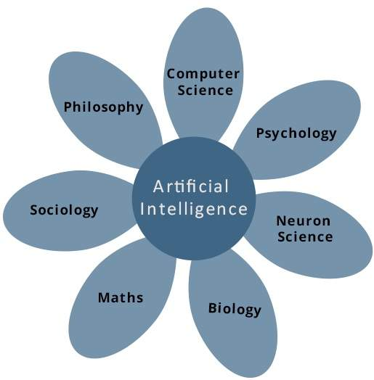
What Contributes to AI?

Slide 16
Applications of AI
Gaming − AI plays crucial role in strategic games such as chess, poker, tic-tac-toe, etc., where machine can think of large number of possible positions based on heuristic knowledge.
Natural Language Processing − It is possible to interact with the computer that understands natural language spoken by humans.
Expert Systems − There are some applications which integrate machine, software, and special information to impart reasoning and advising. They provide explanation and advice to the users.
Vision Systems − These systems understand, interpret, and comprehend visual input on the computer. For example,

Slide 17
Class Activity.
Group selection[Team of 4 and a leader]
Select possible viable projects.
Agree on project timelines[proposals]
  Keep Deadlines.
  Weekly reports on Bboard.
  Presentation day.
  Guest speaker.
  Library
  Class participation.

Slide 18
Sample AI Class projects.
https://data-flair.training/blogs/advanced-python-project-detecting-fake-news/
Visit the link to familiarize yourself with existing projects.

Slide 19


Slide 20

Thank you.

